Slide 1
Data Clustering: Some Other Aspects (K-means++, Overlapping Clustering, Evaluation)
CS771: Introduction to Machine Learning
Piyush Rai

Slide 2
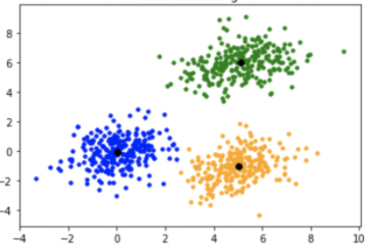
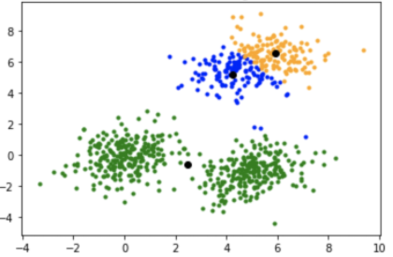
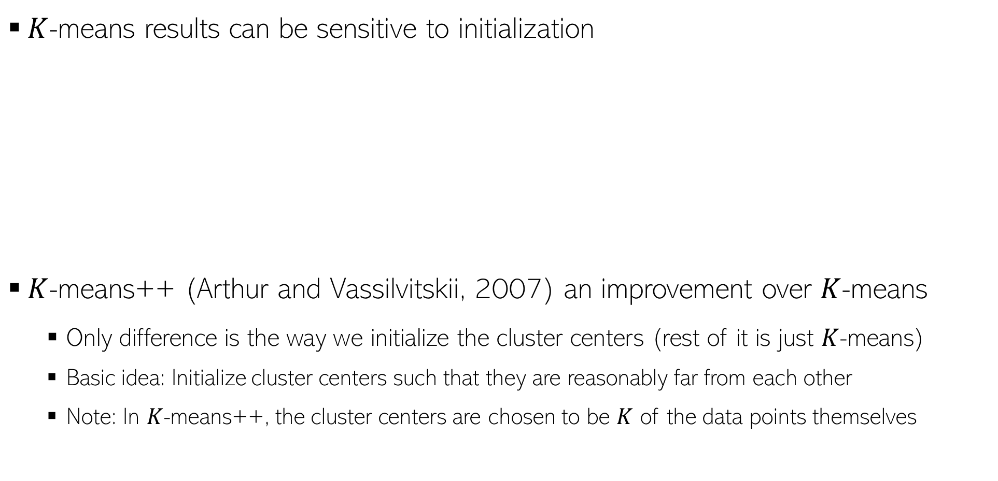
K-means++
$K$-means results can be sensitive to initialization
$K$-means++ (Arthur and Vassilvitskii, 2007) an improvement over $K$-means
Only difference is the way we initialize the cluster centers (rest of it is just $K$-means)
Basic idea: Initialize cluster centers such that they are reasonably far from each other
Note: In $K$-means++, the cluster centers are chosen to be $K$ of the data points themselves
Desired clustering
Poor initialization: bad clustering

Slide 3
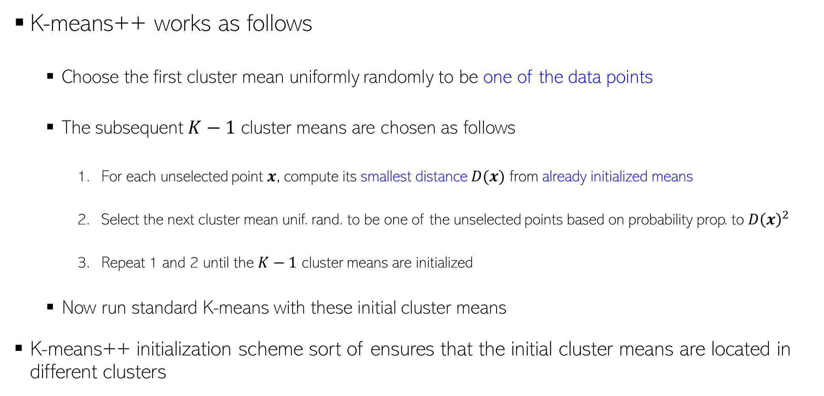
K-means++
K-means++ works as follows
Choose the first cluster mean uniformly randomly to be one of the data points
The subsequent $K−1$ cluster means are chosen as follows
For each unselected point $x$, compute its smallest distance $D(x)$ from already initialized means
Select the next cluster mean unif. rand. to be one of the unselected points based on probability prop. to $D{\left(x\right)}^{2}$
Repeat 1 and 2 until the $K−1$ cluster means are initialized
Now run standard K-means with these initial cluster means
K-means++ initialization scheme sort of ensures that the initial cluster means are located in different clusters
Thus farthest points are most likely to be selected as cluster means

Slide 4
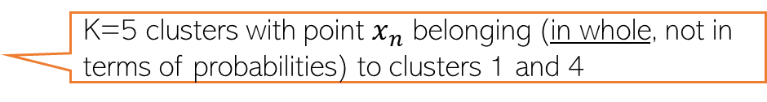

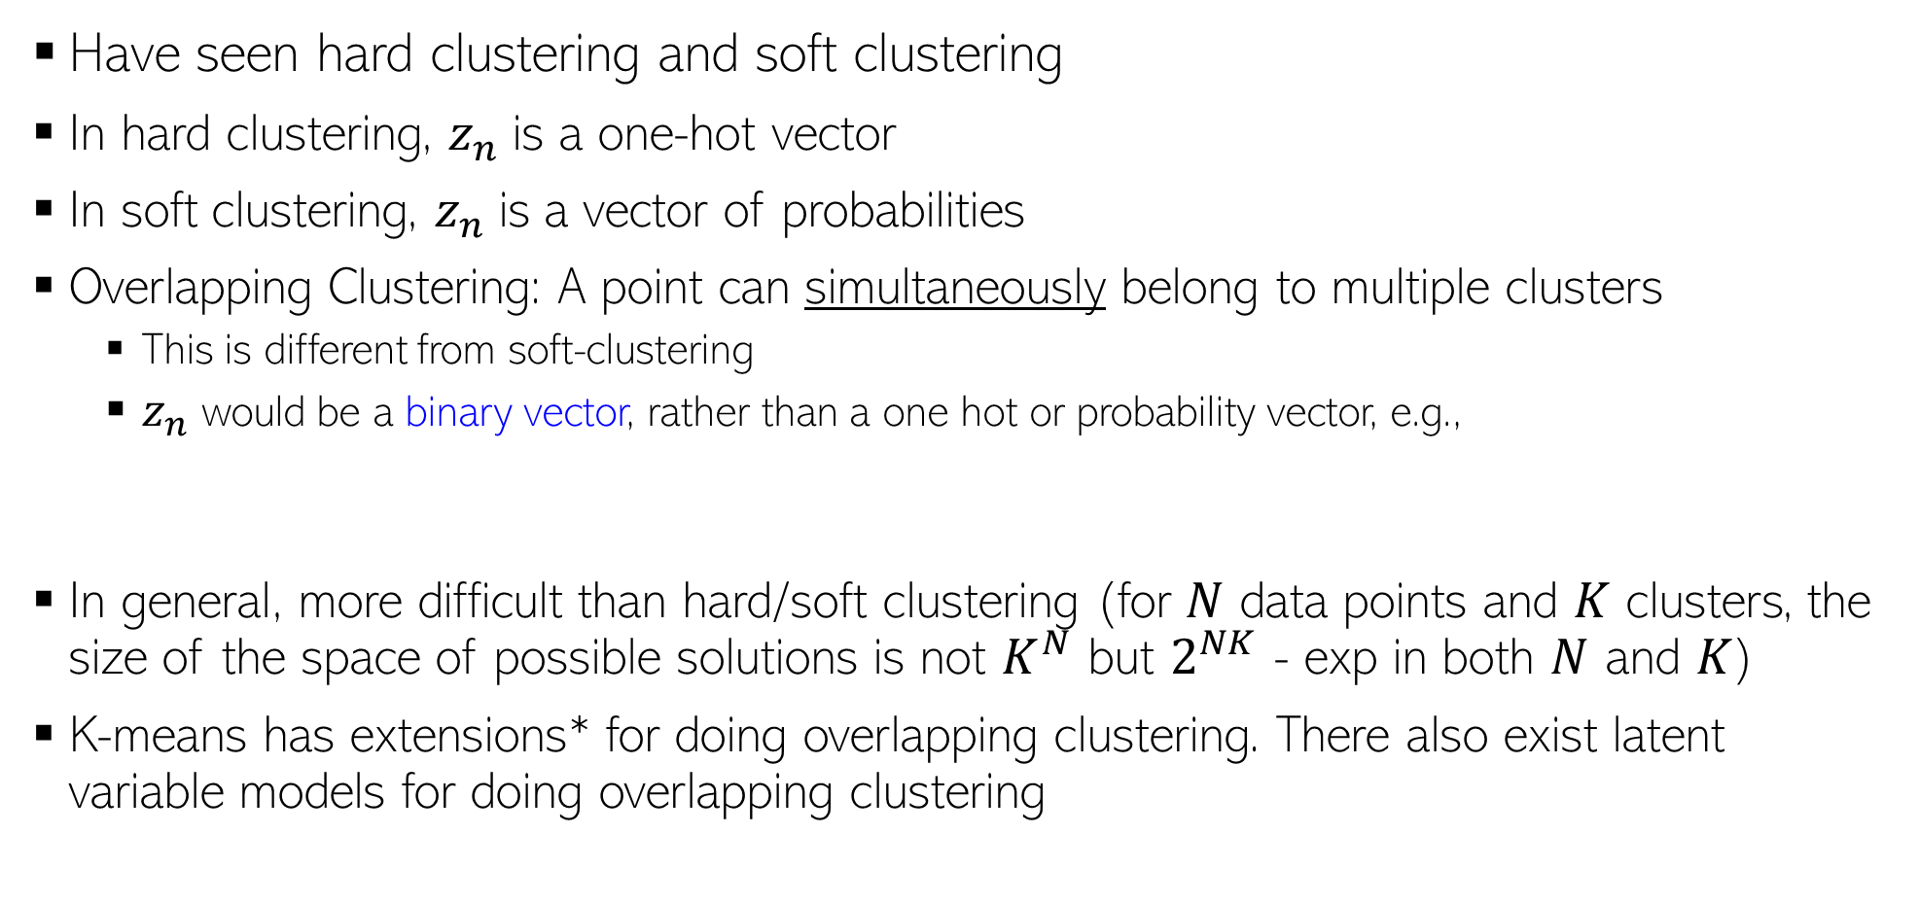
Overlapping Clustering
Kind of unsupervised version of multi-label classification (just like standard clustering is like unsupervised multi-class classification)
Have seen hard clustering and soft clustering
In hard clustering, $z_{n}$is a one-hot vector
In soft clustering, $z_{n}$is a vector of probabilities
Overlapping Clustering: A point can simultaneously belong to multiple clusters
This is different from soft-clustering
$z_{n}$ would be a binary vector, rather than a one hot or probability vector, e.g.,
In general, more difficult than hard/soft clustering (for $N$ data points and $K$ clusters, the size of the space of possible solutions is not $K^{N}$ but $2^{NK}$ - exp in both $N$ and $K$)
K-means has extensions* for doing overlapping clustering. There also exist latent variable models for doing overlapping clustering
Example: Clustering people based on the interests they may have (a person may have multiple interests; thus may belong to more than one cluster simultaneously)
$$z_{n}\text{ = [1 0 0 1 0]}$$
K=5 clusters with point $x_{n}$ belonging (in whole, not in terms of probabilities) to clusters 1 and 4
*An extended version of the k-means method for overlapping clustering (Cleuziou, 2008); Non-exhaustive, Overlapping k-means (Whang et al, 2015)

Slide 5
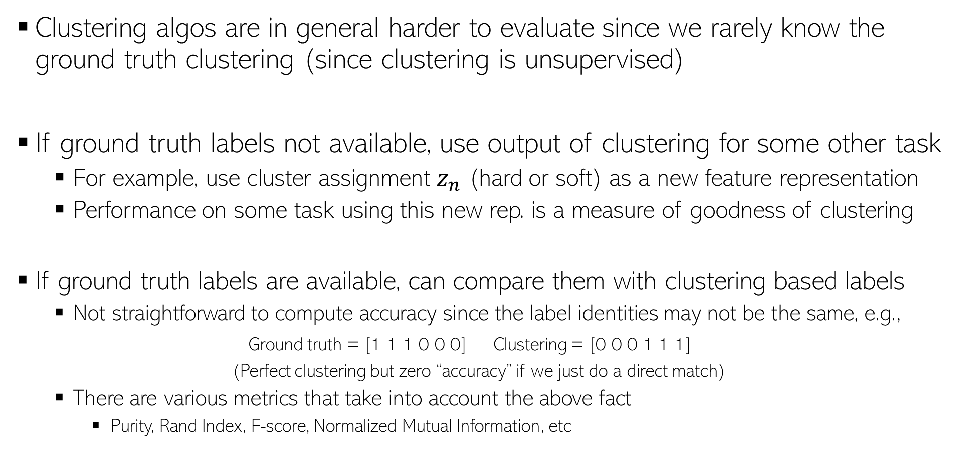
Evaluating Clustering Algorithms
Clustering algos are in general harder to evaluate since we rarely know the ground truth clustering (since clustering is unsupervised)
If ground truth labels not available, use output of clustering for some other task
For example, use cluster assignment $z_{n}$ (hard or soft) as a new feature representation
Performance on some task using this new rep. is a measure of goodness of clustering
If ground truth labels are available, can compare them with clustering based labels
Not straightforward to compute accuracy since the label identities may not be the same, e.g.,
Ground truth = [1 1 1 0 0 0] Clustering = [0 0 0 1 1 1]
(Perfect clustering but zero “accuracy” if we just do a direct match)
There are various metrics that take into account the above fact
Purity, Rand Index, F-score, Normalized Mutual Information, etc

Slide 6
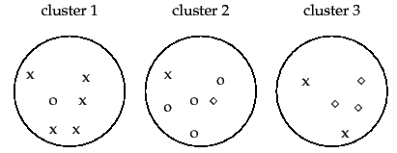




Evaluating Clustering Algorithms
Purity: Looks at how many points in each cluster belong to the majority class in that cluster
Rand Index (RI): Can also look at what fractions of pairs of points with same (resp. different) label are assigned to same (resp. different) cluster
Sum and divide by total number of points
3 classes (x, o , , assuming known ground truth labels)
5
4
3
Purity = (5+4+3)/17 $≈0.71$
Close to 0 for bad clustering, 1 for perfect clustering
Also a bad metric if number of clusters is very large – each cluster will be kind of pure anyway
True Positive: No. of pairs with same true label and same cluster
True Negative: No. of pairs with diff true label and diff clusters
$F_{β}$score is also popular
Precision
Recall
False Positive: No. of pairs with diff true label and same cluster
False Negative: No. of pairs with same true label and diff cluster

Slide 7
Coming up next
Latent variable models

